Slide 1
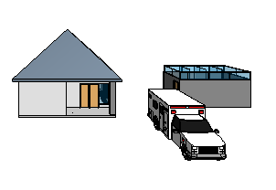
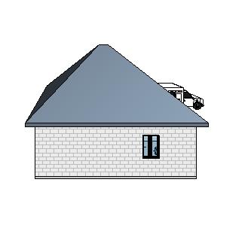
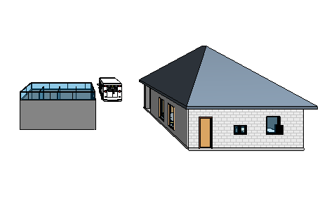
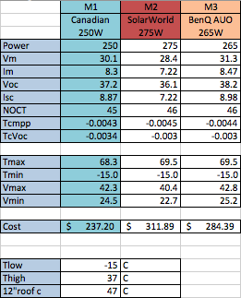
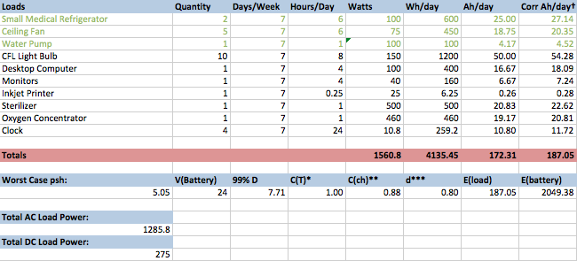
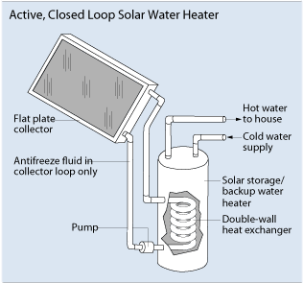
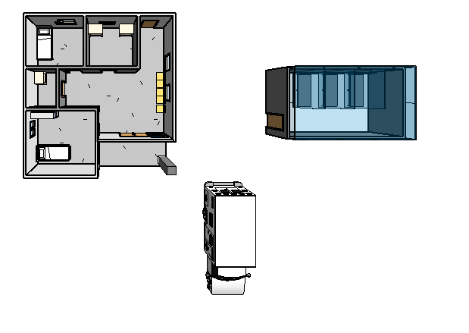
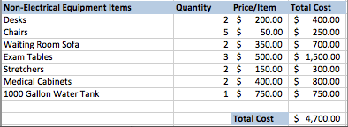
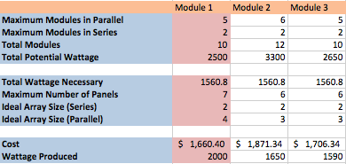
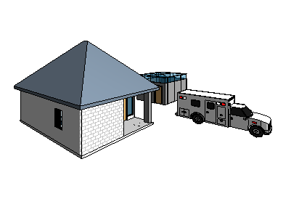
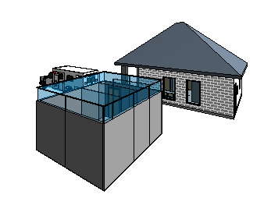
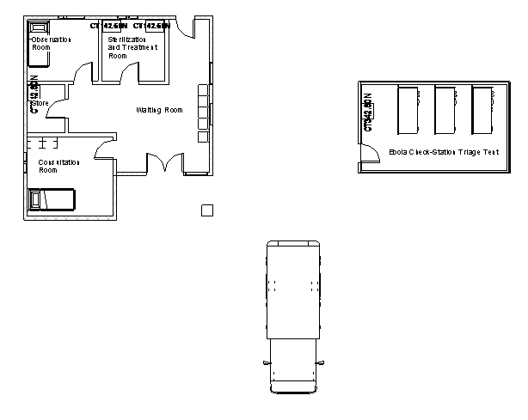
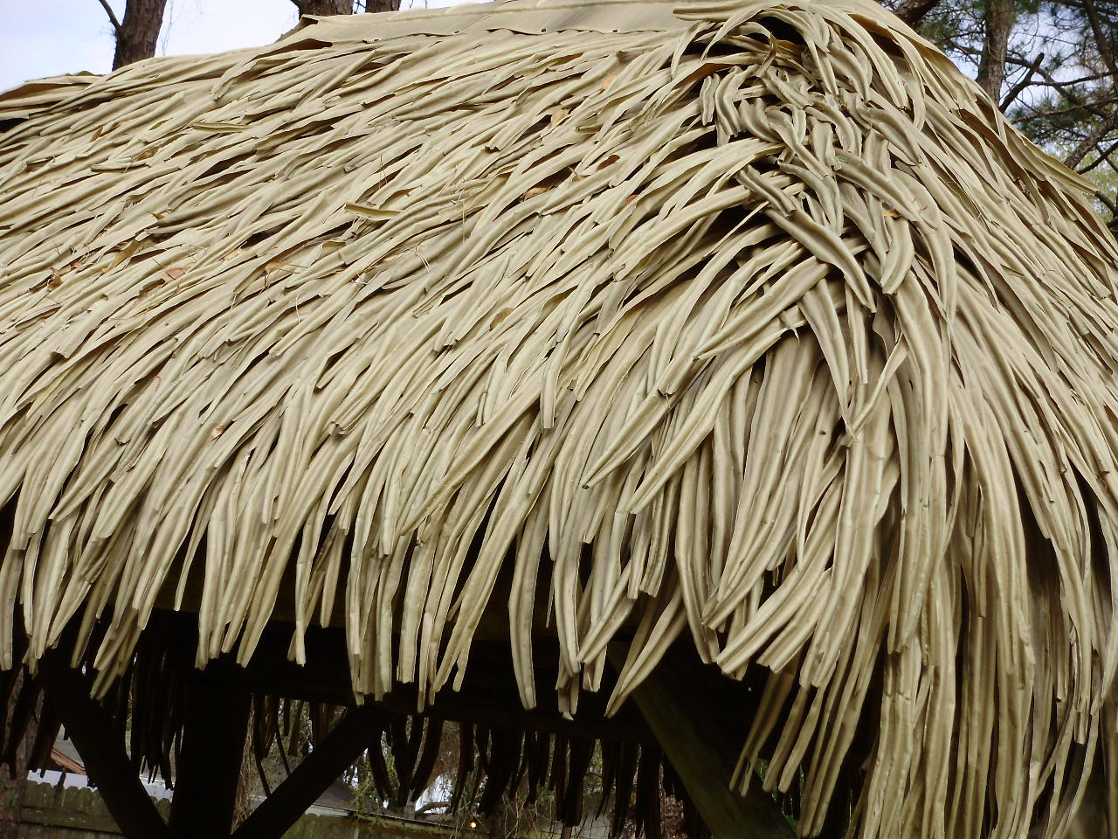
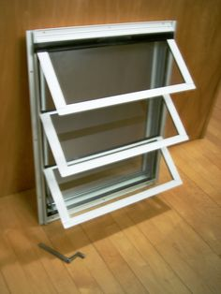
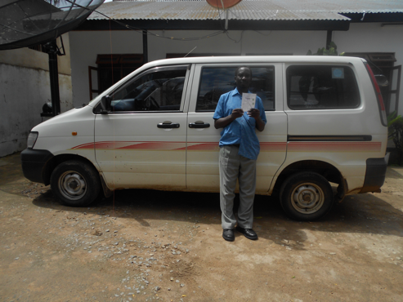
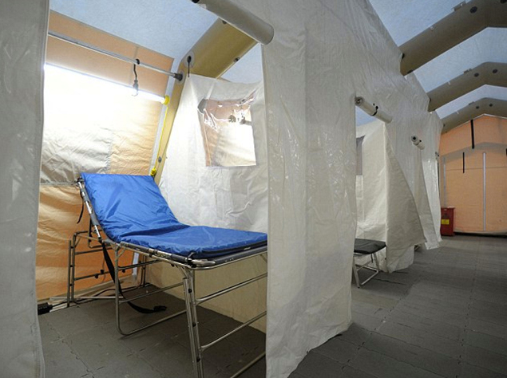
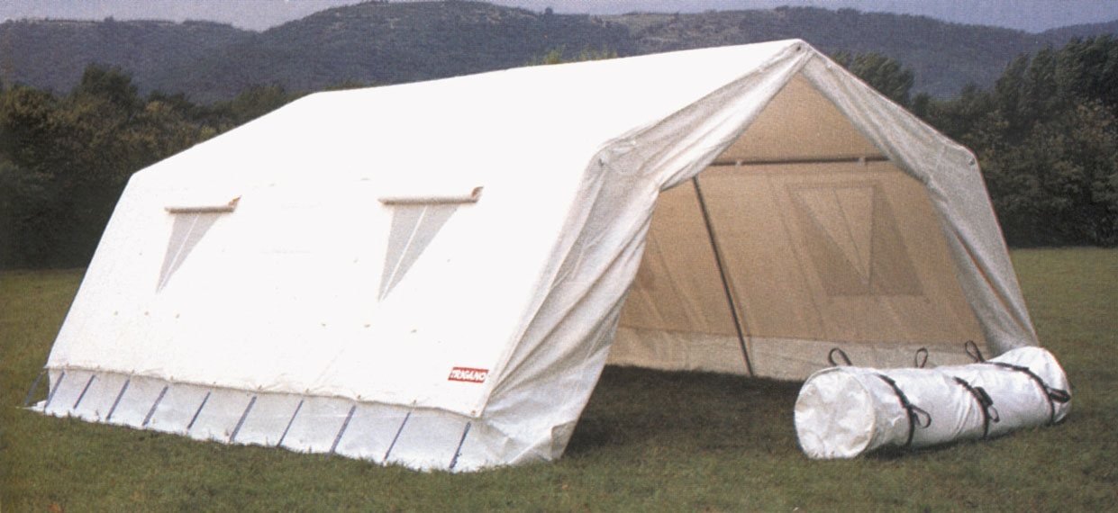
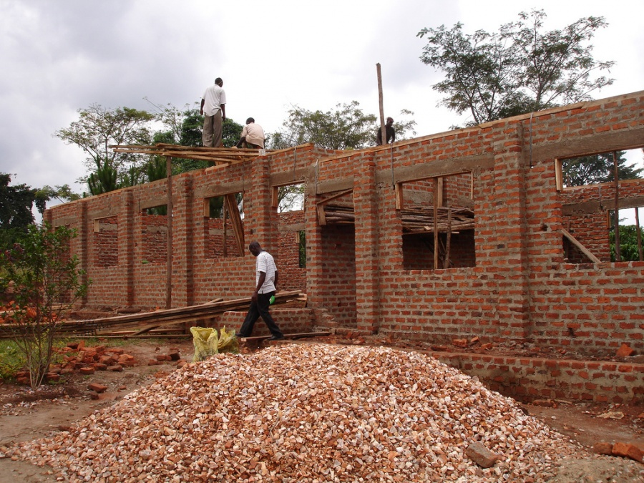
Primary Care Medical Health Center
Sierra Leone
Brynne Kirsch, Sarah Fay, Michael Graziano
EGR 343: Green Architectural Engineering
Elizabethtown College, Elizabethtown, PA
Materials Used
Roof: Thatch
Ventilation
Rain proof
Insulation- warm in winter, cool in summer (thermally efficient)
Local manufacturing
Walls: Bricks
Local manufacturing and commonly installed
Sturdy
Low cost
Floor/Interior: Cement
Easily hosed off or mopped (painted pale yellow)
In sterilization and treatment room, observation room, and consolation room there will be ceramic tile
Water Heating
Uses method of solar water heating
Solar collectors positioned on top of roof collect solar energy and heat specialized water tank heating system
Energy efficient, requires no excess wattage
PV System
Maximum of 3kW total wattage generated by PV system
Off-Grid system
Loads estimated; total wattage and E_{battery} calculated while following derating factors, peak sun hours for location, etc.
Some DC loads used in order to save wattage (highlighted in green), less loads running through inverter
AC loads must run through inverter
The number of panels selected (8) are able to all fit on the South facing side of thatched roof. Set at 20 degree tilt
Wattage found to be less than 3kW maximum
Theoretical solar panel voltages and maximum currents compared to find nominal number of panels to match load
8 250W solar panels chosen
Battery voltage set at 24V, E_{battery} requires 2049Ah. Battery selected fulfills needs
Inverter and charge controller selected accordingly
S

